Slide 1
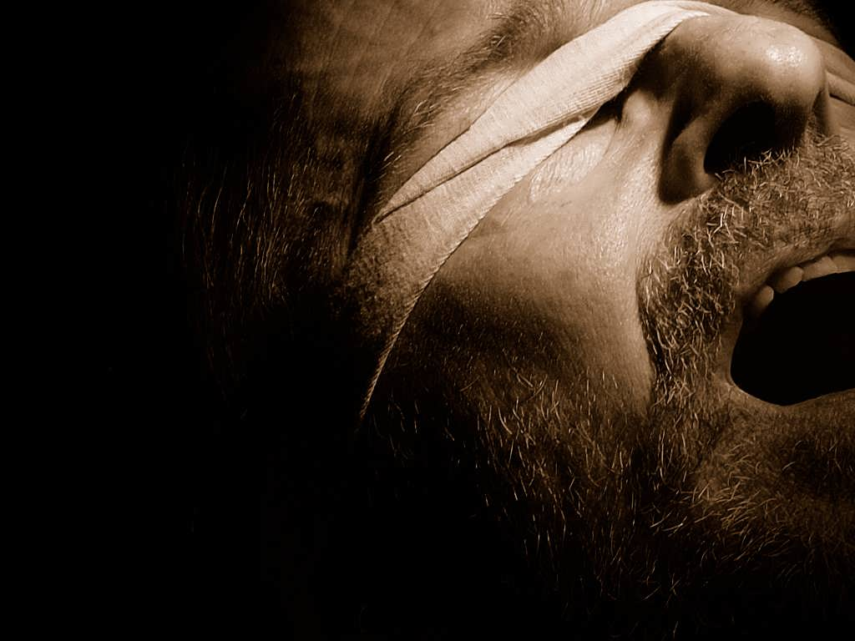


the bondage of
Cults and Isms
Mormonism
A free CD of this message will be available following the service
It will also be available for podcast later this week at calvaryokc.com

Slide 2
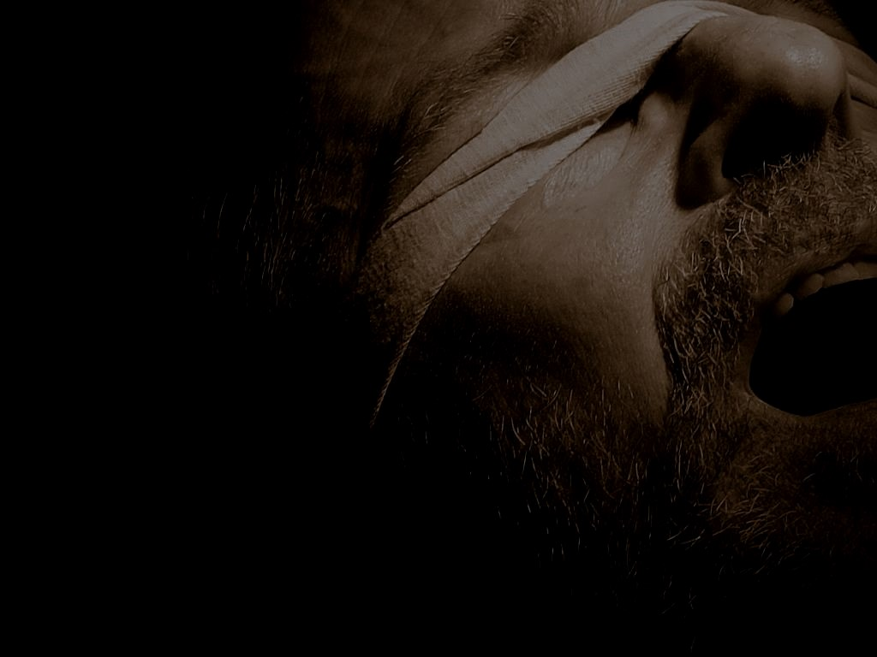
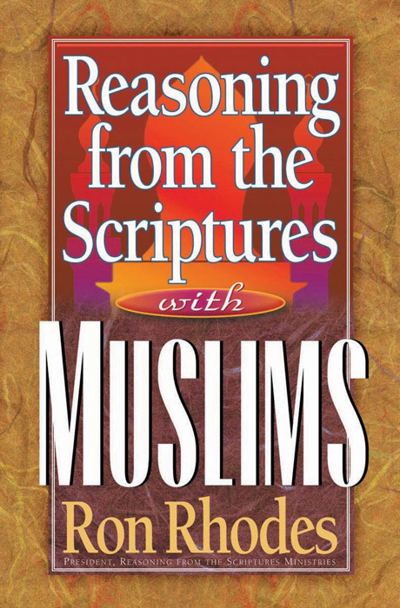

$10.50
$11.50
the bondage of Mormonism
$10.50

Slide 3
the bondage of Mormonism

Slide 4
What is a cult?
1. Who Jesus is
1 John 4:3 ~ … every spirit that does not confess that Jesus Christ has come in the flesh is not of God. And this is the spirit of the Antichrist, which you have heard was coming, and is now already in the world.
the bondage of Mormonism

Slide 5
What is a cult?
2. What Jesus did
Gal. 1:8 ~ But even if we, or an angel from heaven, preach any other gospel to you than what we have preached to you, let him be accursed.
the bondage of Mormonism

Slide 6
What is a cult?
3. The Resurrection
1 Cor. 15:17 ~ And if Christ is not risen, your faith is futile; you are still in your sins!
the bondage of Mormonism

Slide 7
What is a cult?
1. Who Jesus is
The Incarnation
2. What Jesus did
Salvation by grace through faith
3. The Resurrection
Physical and immortal
the bondage of Mormonism

Slide 8
Sound Doctrine
False Doctrine
Truth-o-meter
What I believe
Things I disagree with
Aberrant beliefs
Heresy
the bondage of Mormonism

Slide 9
5th president of the LDS, Lorenzo Snow ~ “As god was, man is; as god is, man may become." (the Doctrine of Eternal Progression)
the bondage of Mormonism

Slide 10
the bondage of Mormonism

Slide 11
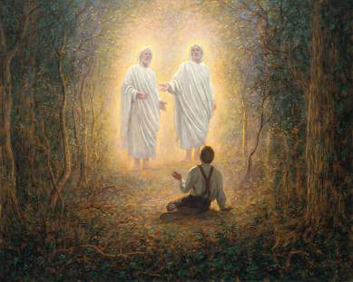
Smith’s “First Vision” (1820)
the bondage of Mormonism

Slide 12
“1st vision” 1820
Smith killed
July 27, 1844
Ohio, Missouri, Illinois migrations
1830-1844
Migration to Nebraska
1846
1820
1824
1828
1832
1836
1840
1844
1848
Subsequent visions
1820-1830
Book of Mormon
1830
Migration to Utah
1847
the bondage of Mormonism

Slide 13
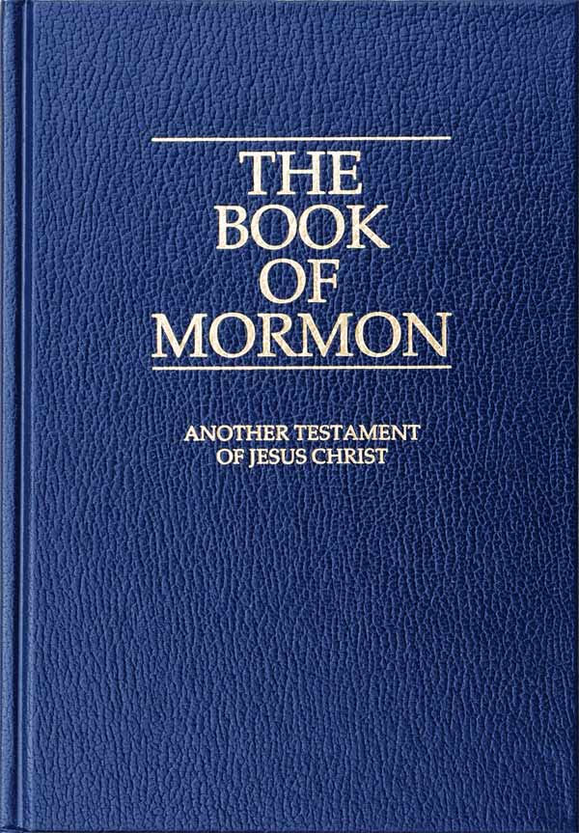

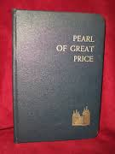
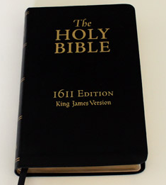
the bondage of Mormonism

Slide 14
The Book of Mormon
Covers the history of the Americas from 2200 BC to AD 421
Begins with the migration of Lehi and his family from Jerusalem around 600 BC
the bondage of Mormonism

Slide 15
the bondage of Mormonism

Slide 16

the bondage of Mormonism

Slide 17
Doctrine and Covenants
Originally published in 1835
Two parts:
“Lectures on the Faith" (Doctrine)
Revelations from early leaders
Two “Official Declarations":
Reversal of policy on plural marriages
Reversal of policy of admitting African-Americans to the priesthood
the bondage of Mormonism

Slide 18
Pearl of Great Price
Contains 5 sections, written by Smith plus the Articles of Faith
Canonized in 1880
the bondage of Mormonism

Slide 19
KJV Bible
“Insofar as it's correctly translated"
the bondage of Mormonism

Slide 20
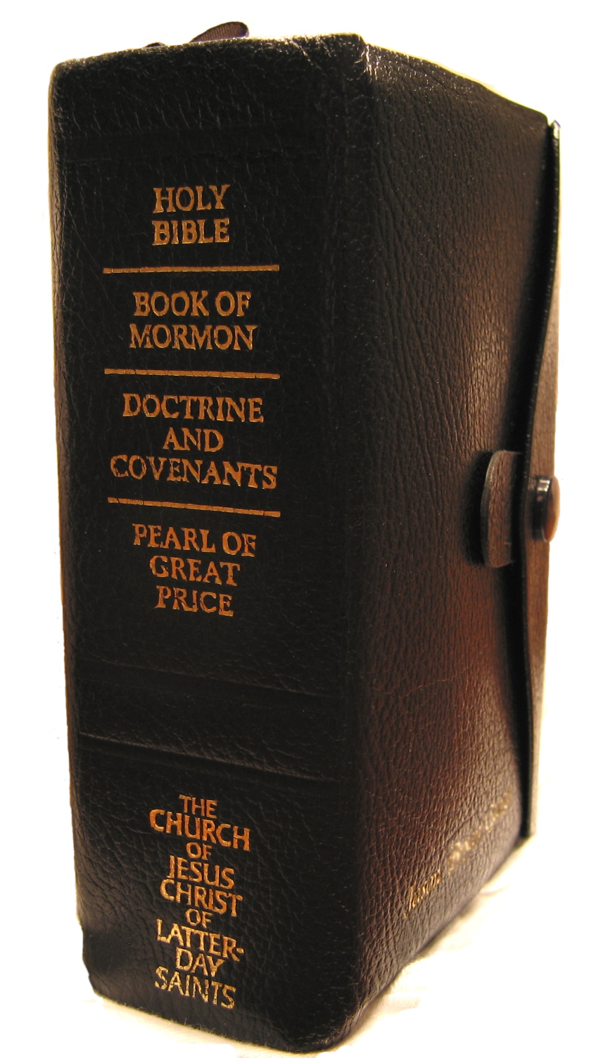
The Whole Shebang
the bondage of Mormonism

Slide 21
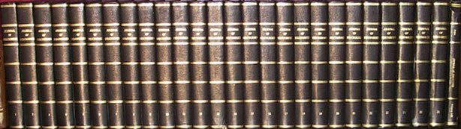
26 volume “Journal of Discourses”
(compiled 1854-1886)
the bondage of Mormonism

Slide 22
the bondage of Mormonism

Slide 23

the bondage of Mormonism

Slide 24
the bondage of Mormonism

Slide 25
Mormonism Growth Chart
14,000,000
12,000,000
10,000,000
8,000,000
6,000,000
4,000,000
2,000,000
1830
1850
1870
1890
1910
1930
1950
1970
1990
2010
the bondage of Mormonism

Slide 26
Moroni 10:4 ~ … I would exhort you that ye would ask God, the Eternal Father, in the name of Christ, if these things are not true; and if ye shall ask with a sincere heart, with real intent, having faith in Christ, he will manifest the truth of it to you, by the power of the Holy Ghost.
the bondage of Mormonism

Slide 27
the bondage of Mormonism

Slide 28
Brigham Young ~ “Now, let all who may hear these doctrines, pause before they make light of them, or treat them with indifference, for they will prove their salvation or damnation." (JD, 1:51)
the bondage of Mormonism

Slide 29
Joseph Smith ~ “ I was answered that I must join none of them, for they were all wrong; and the Personage who addressed me said that all their creeds were an abomination in his sight; that those professors were all corrupt." (PGP, History, 2:19)
the bondage of Mormonism

Slide 30
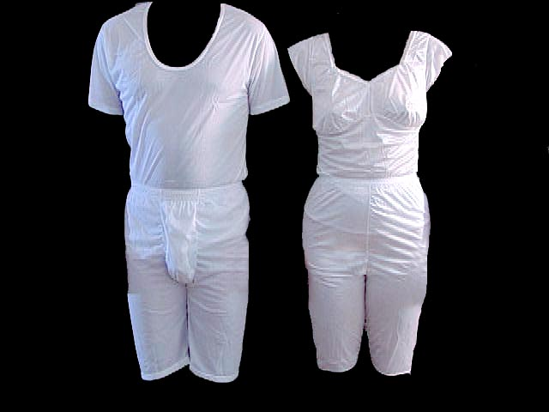
The “Temple garments" (aka, the “holy underwear")
the bondage of Mormonism

Slide 31
the bondage of Mormonism

Slide 32
“We believe that men will be punished for their own sins, and not for Adam’s transgression." (PGP, Articles of Faith, 2)
the bondage of Mormonism

Slide 33
Mormon Concept of Deity | Biblical Concept of Deity
Physical body
Immaterial (spirit)
Mortal, finite
Immortal, infinite
Changeable, evolving
Immutable
Physically localized
Omnipresent
Polygamous, incestuous
Monogamous (celibate)
Polytheistic
Monotheistic
Tri-theistic
Trinitarian
Exalted, saved man
Eternal deity
Jesus, begotten by Elohim's physical intercourse with Mary
Jesus, begotten supernaturally by the Holy Spirit (virgin birth)
the bondage of Mormonism

Slide 34
Mormon Jesus | Biblical Jesus
Physical body, elder brother of Lucifer
Uncreated God
Considered lesser, and one of many gods
Unique, 2nd Person of the Triune Godhead
Conceived by physical intercourse between Elohim and Mary
Conceived by the Holy Spirit, virgin born
the bondage of Mormonism

Slide 35
Mormon Jesus | Biblical Jesus
Once sinful and imperfect
Eternally sinless and perfect
Earned salvation and exalted godhead
As God, never required salvation
Married polygamist
Unmarried, monogamist
the bondage of Mormonism

Slide 36
the bondage of Mormonism

Slide 37
Alma 7:10 ~ And behold, he shall be born of Mary, at Jerusalem, which is the land of our forefathers …
the bondage of Mormonism

Slide 38
the bondage of Mormonism

Slide 39
Gal. 1:8 ~ But even if we, or an angel from heaven, preach any other gospel to you than what we have preached to you, let him be accursed.
the bondage of Mormonism

Slide 40
the bondage of Mormonism

Slide 41
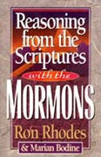

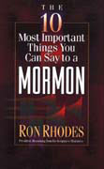
$11.50
$2.00 (tract)
$7.00
the bondage of Mormonism

Slide 42
the bondage of Mormonism

